Slide 1
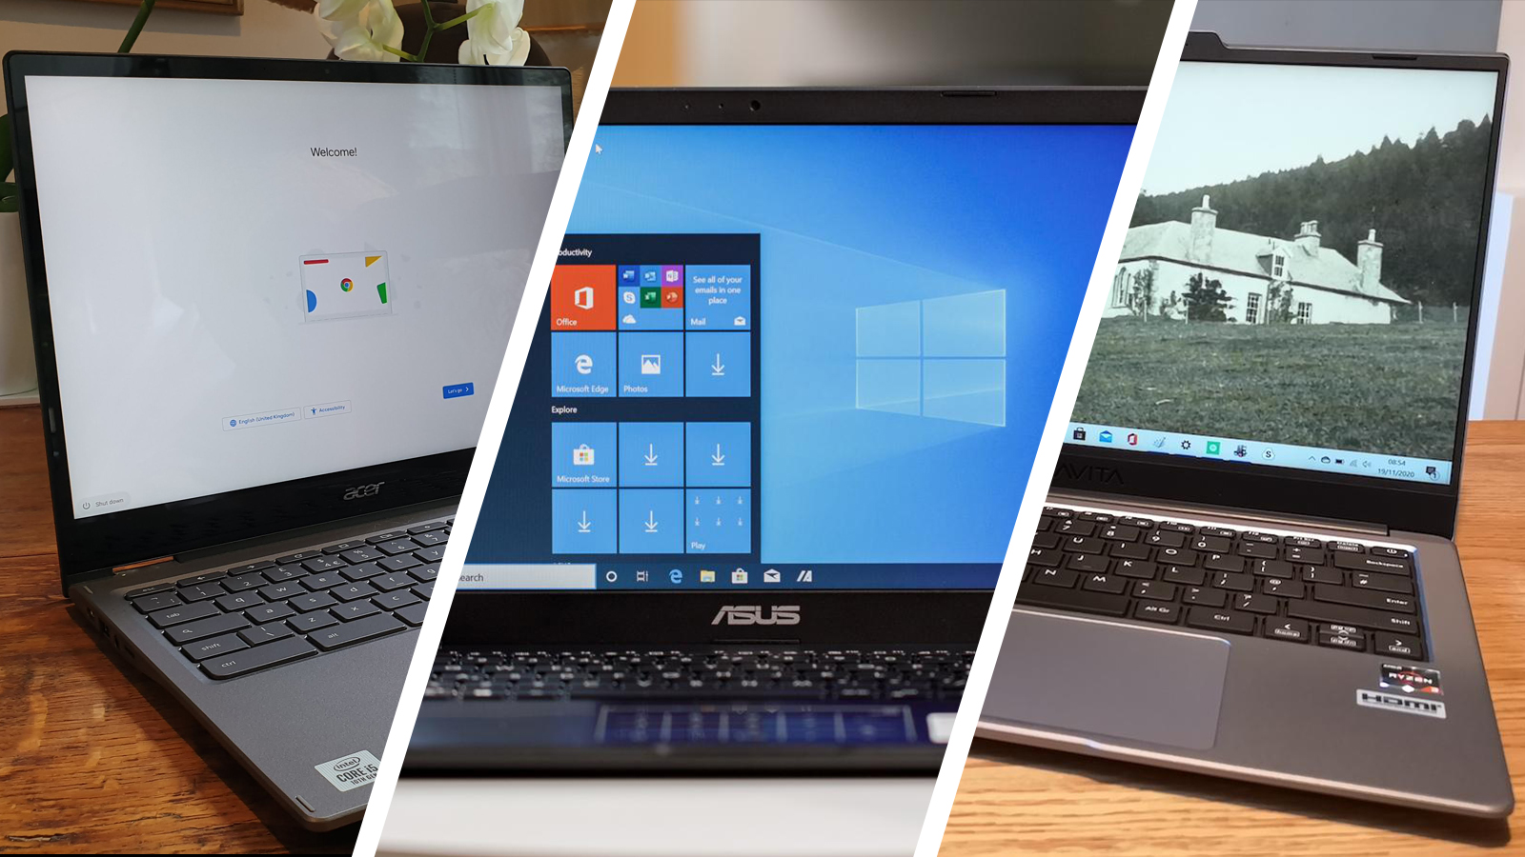
Laptop Price Prediction
SAURABH GANGWAR (C0894380)
Submitted to: PROF. ISHANT GUPTA

Slide 2
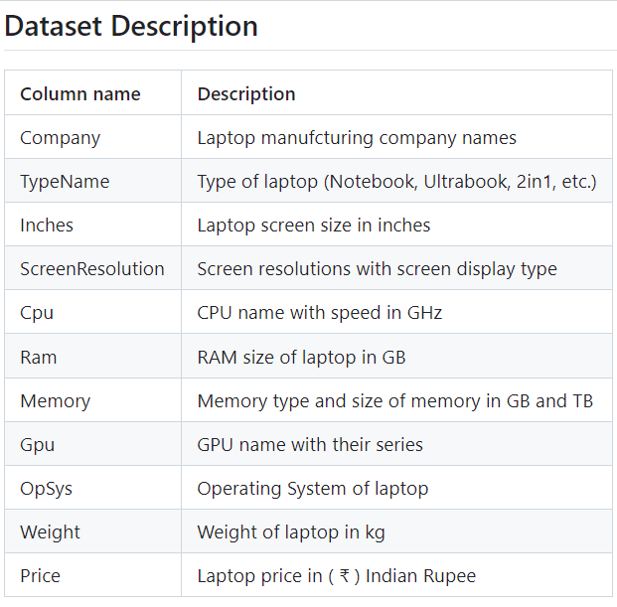
Project Description
In this project, a supervised machine learning model is built to predict tentative laptop prices based on its specifications.
This model is trained on a dataset that is taken from Kaggle.
The dataset contains laptop specifications and corresponding prices.
The description of this dataset is as follows:

Slide 3
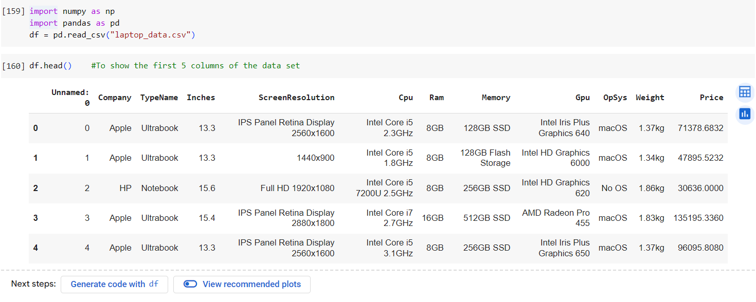
Importing The Dataset

Slide 4
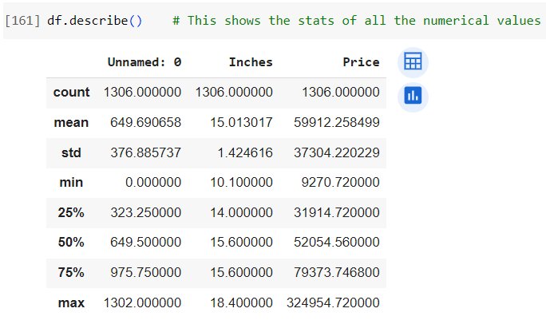
Description Of Data

Slide 5
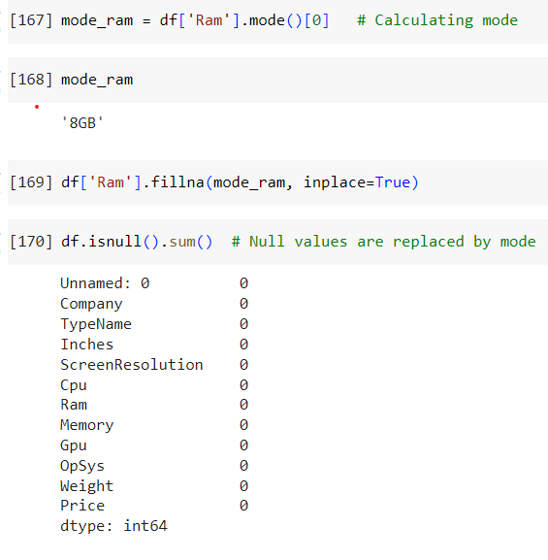
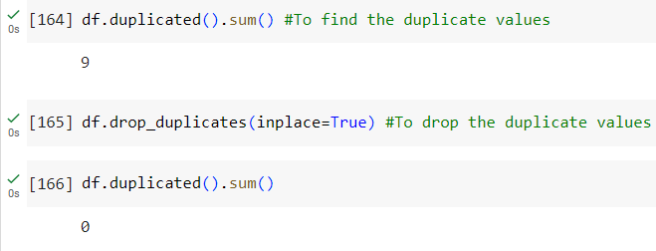
Data Cleaning
Removing duplicates
Removing null values

Slide 6
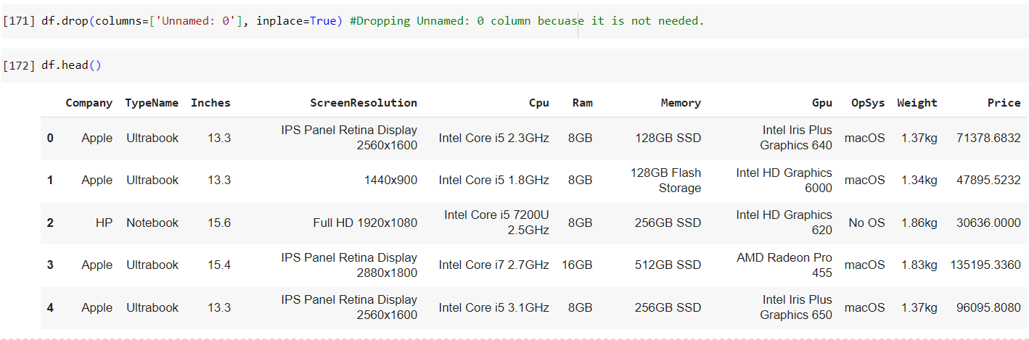
Data Preprocessing
Dropping unnecessary columns

Slide 7
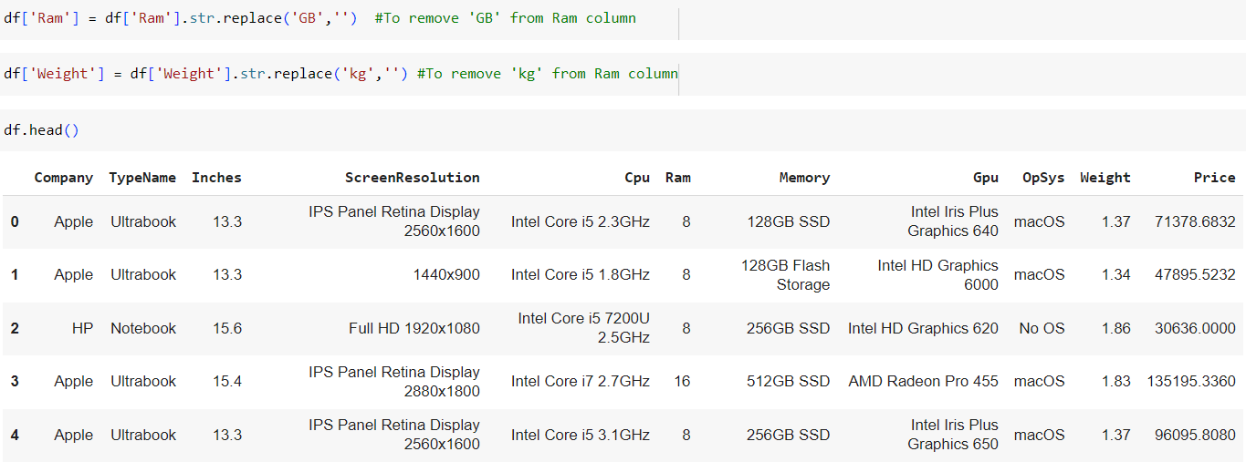
Data Preprocessing
Removing ‘GB’ and ‘kg’ words from Ram and Weight column

Slide 8
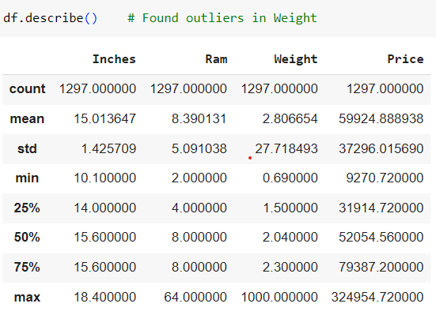
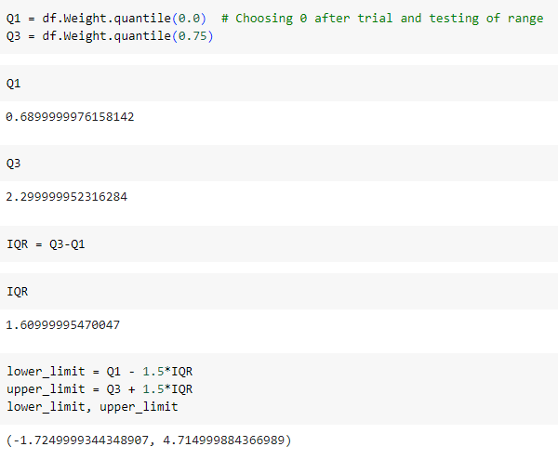

Data Preprocessing
Outlier detection

Slide 9
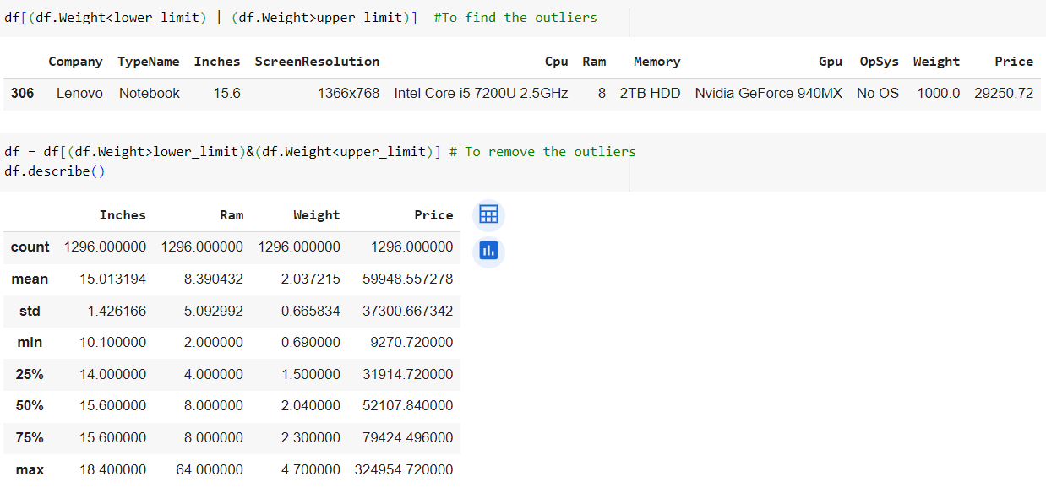
Data Preprocessing

Slide 10

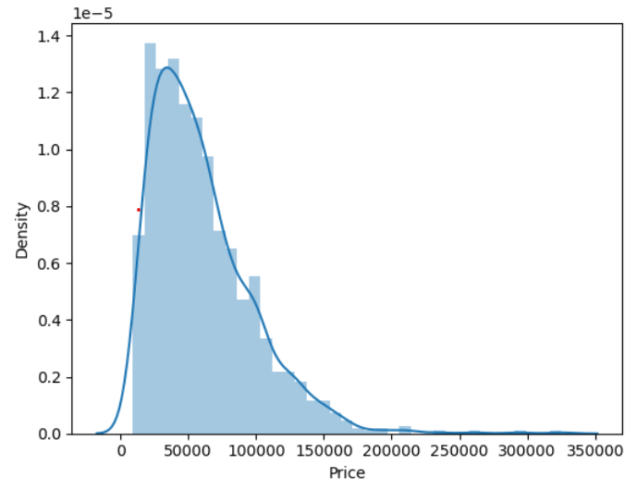
Exploratory Data Analysis

Slide 11
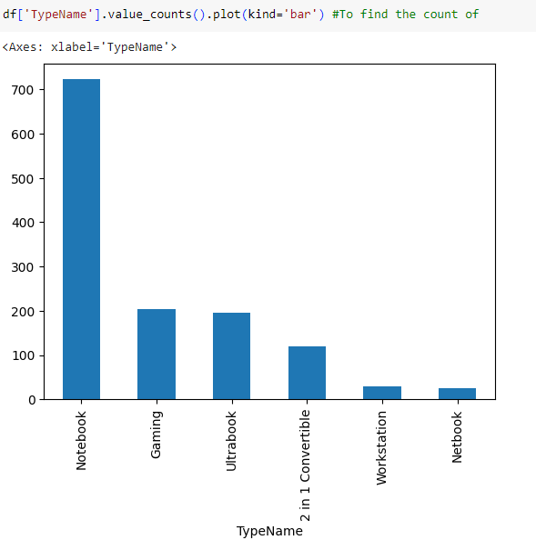
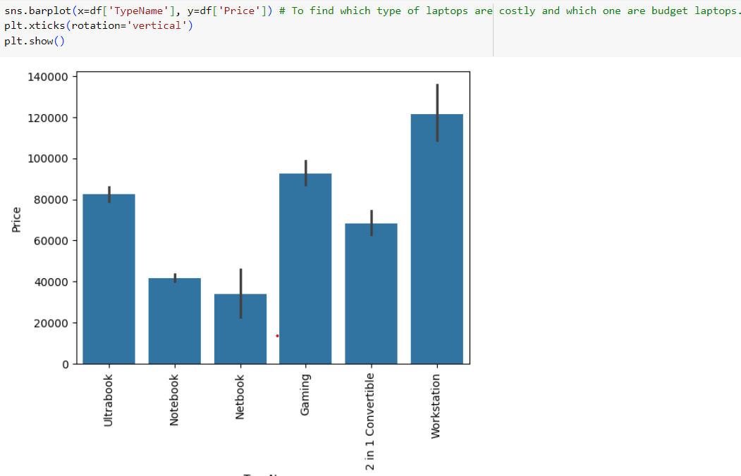
Exploratory Data Analysis

Slide 12
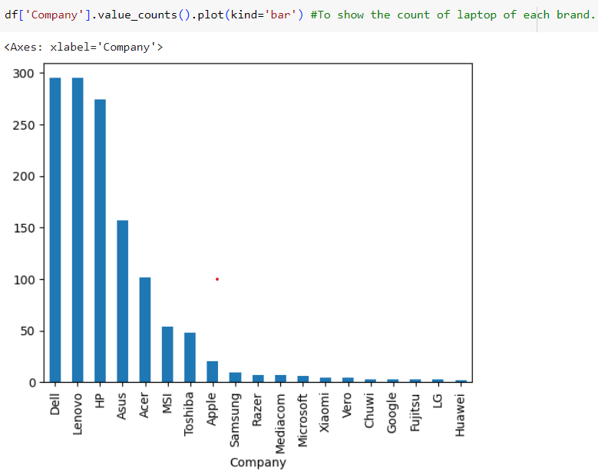
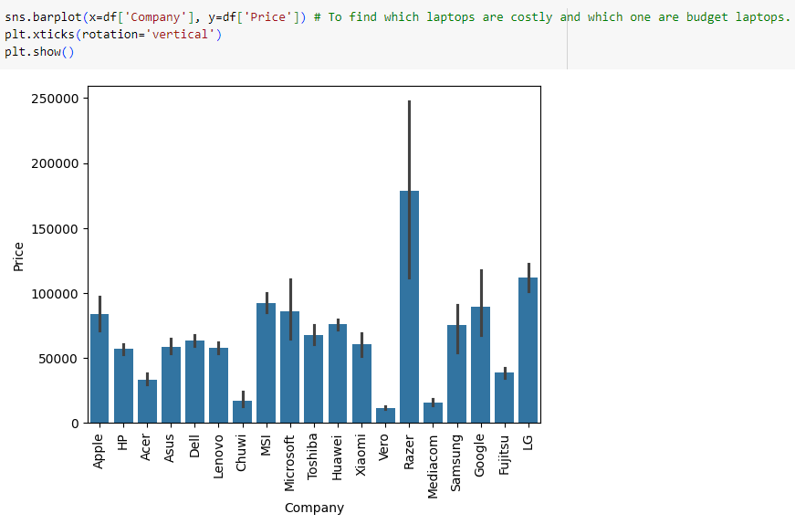
Exploratory Data Analysis

Slide 13

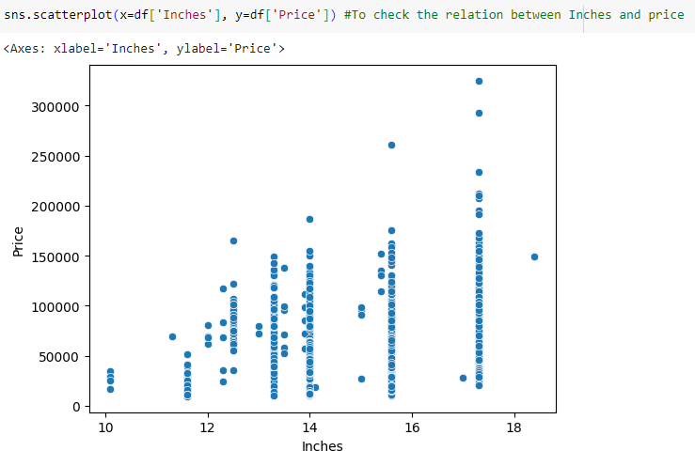
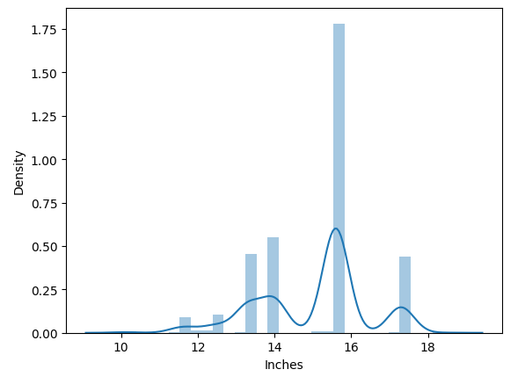
Exploratory Data Analysis

Slide 14
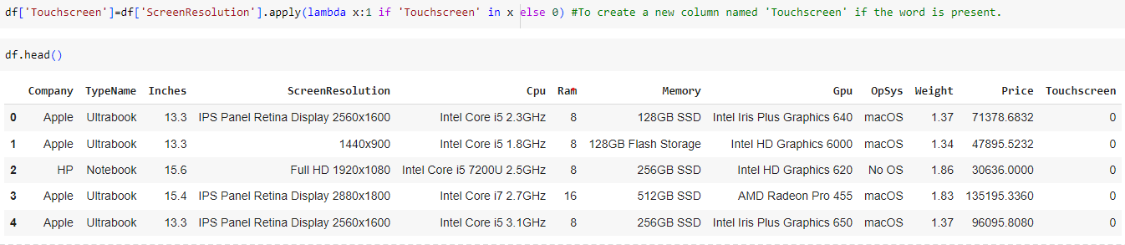
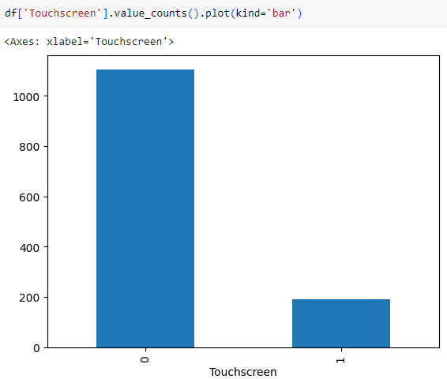
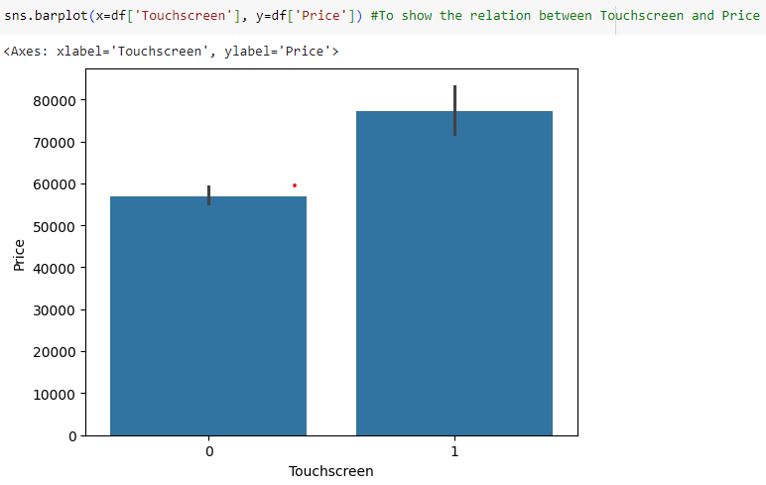
Exploratory Data Analysis

Slide 15
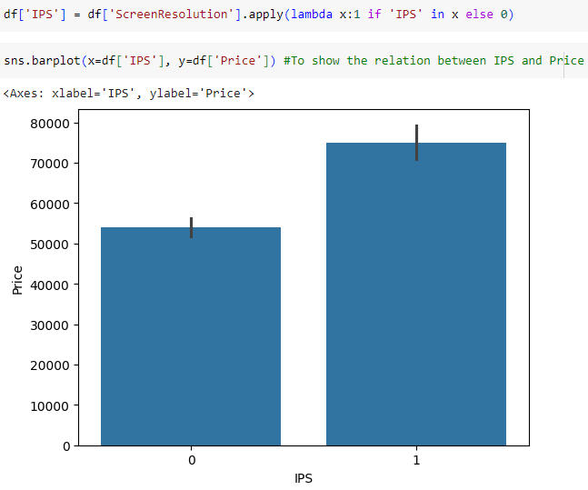
Exploratory Data Analysis

Slide 16
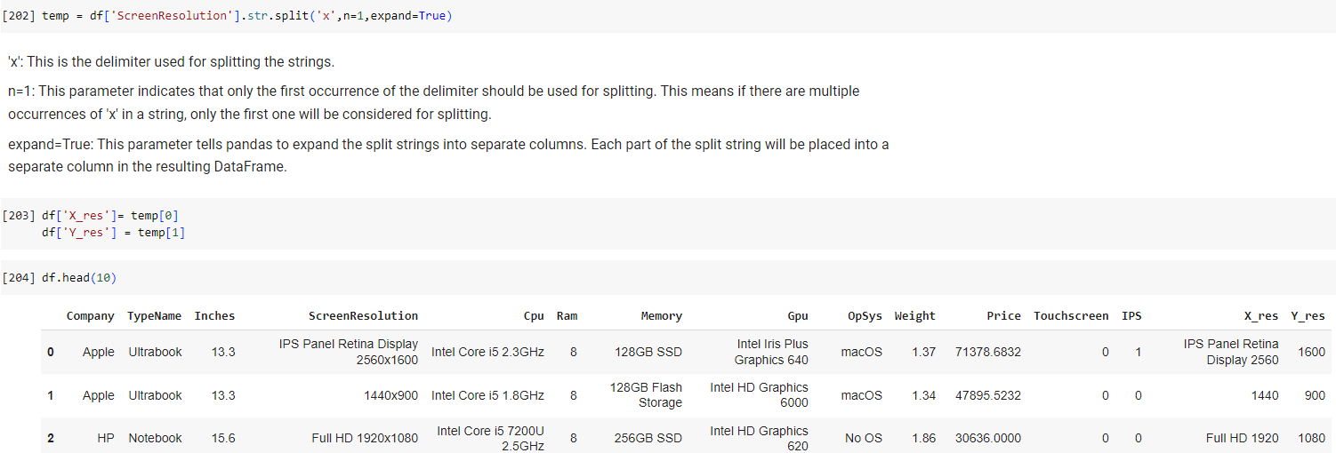
Exploratory Data Analysis
Extracting resolution form ScreenResolution column

Slide 17
Exploratory Data Analysis

Slide 18
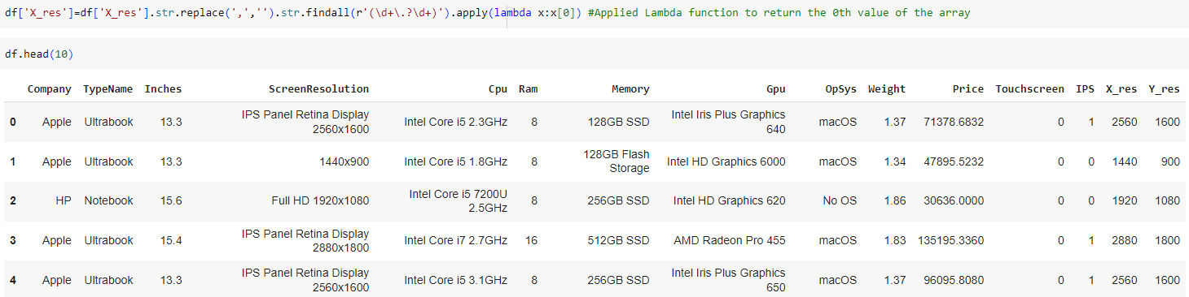

Exploratory Data Analysis
Extracting resolution for X_res

Slide 19
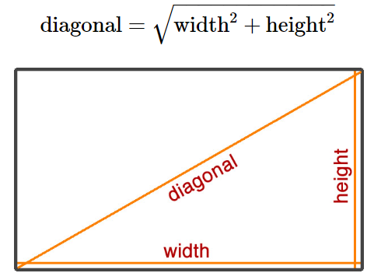

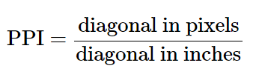
Exploratory Data Analysis
Extracting PPI column

Slide 20
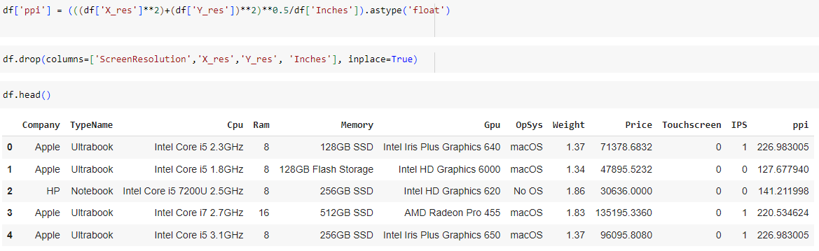
Exploratory Data Analysis

Slide 21
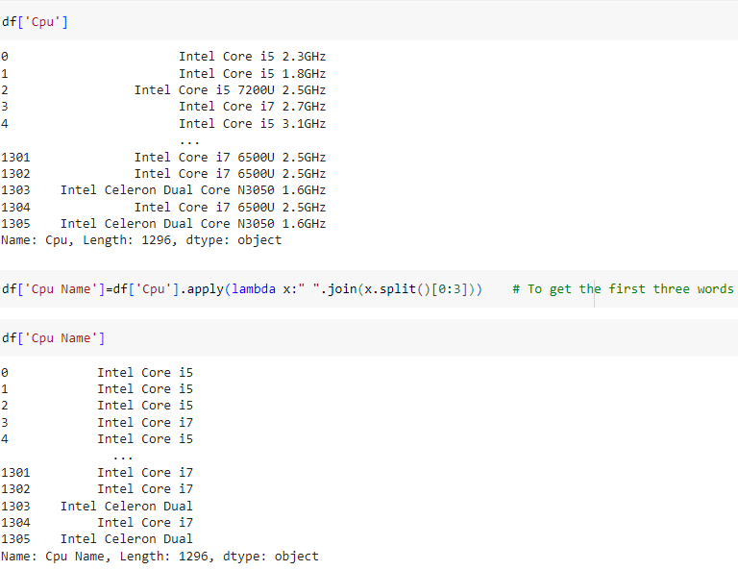
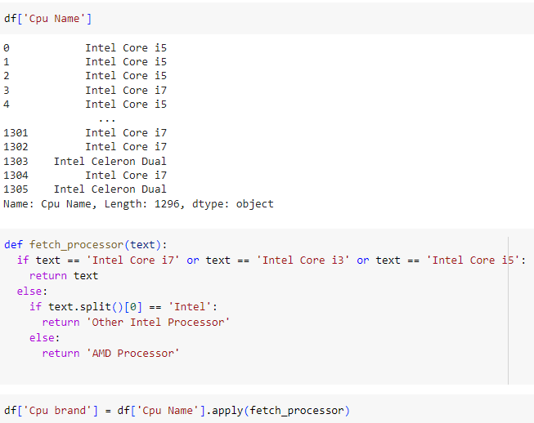
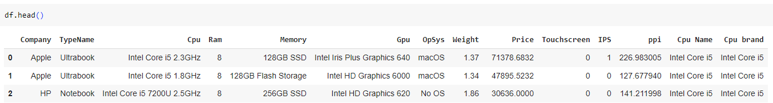
Exploratory Data Analysis
Grouping the “Cpu” column into “Cpu Brand”

Slide 22
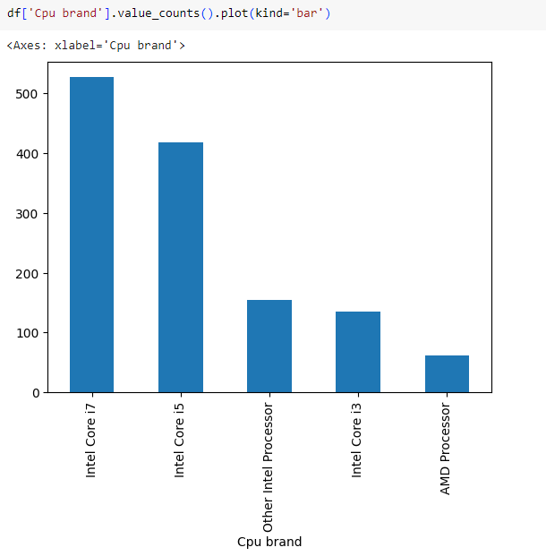
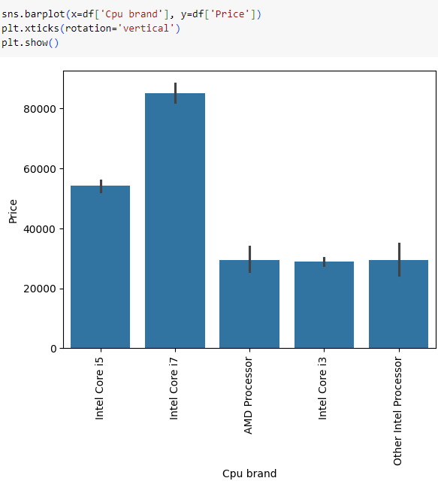
Exploratory Data Analysis
CPU Brand vs Price

Slide 23
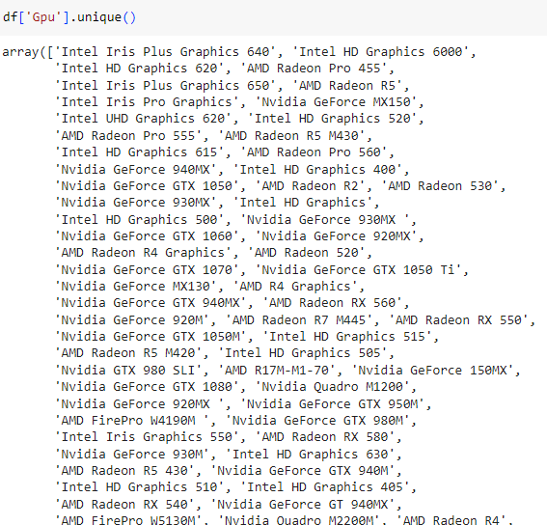
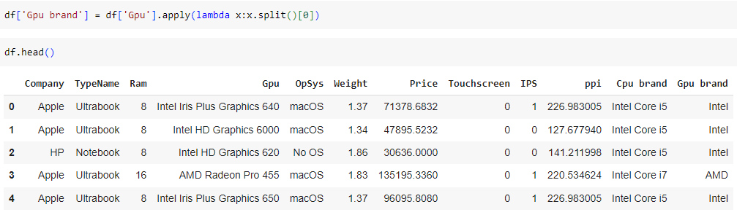
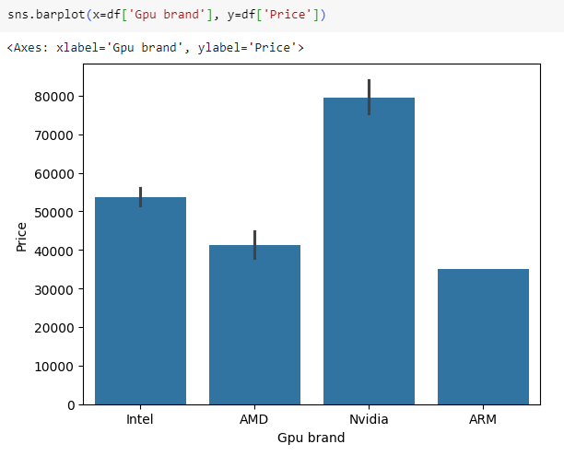
Exploratory Data Analysis
Grouping the “Gpu” column into “Gpu Brand”

Slide 24
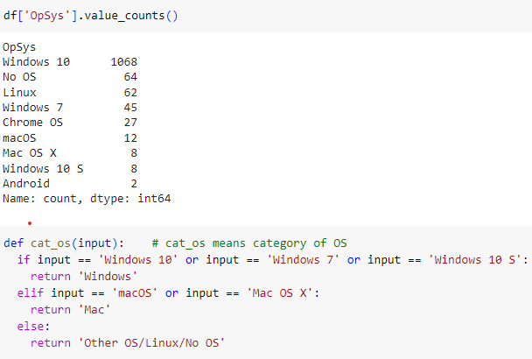
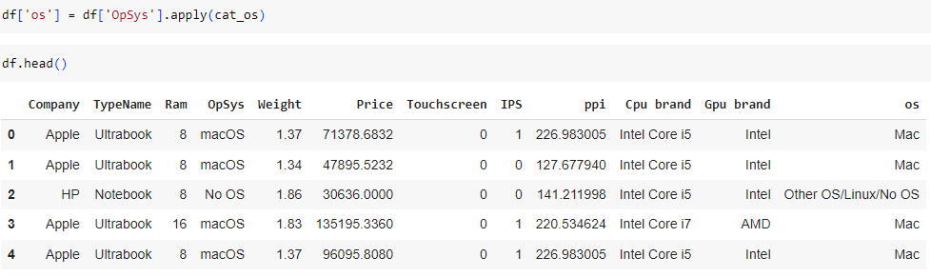
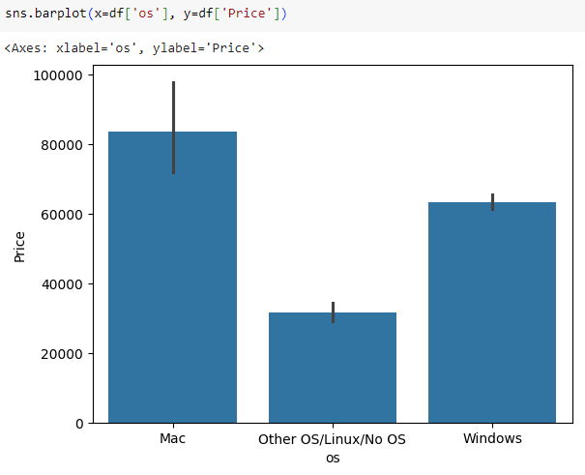
Exploratory Data Analysis
Grouping the “OpSys” column into “OS” (operating system).

Slide 25
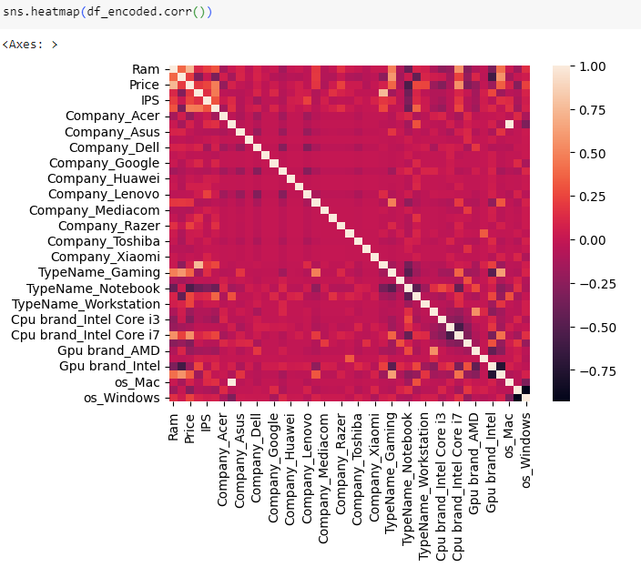
Exploratory Data Analysis
Heat map

Slide 26
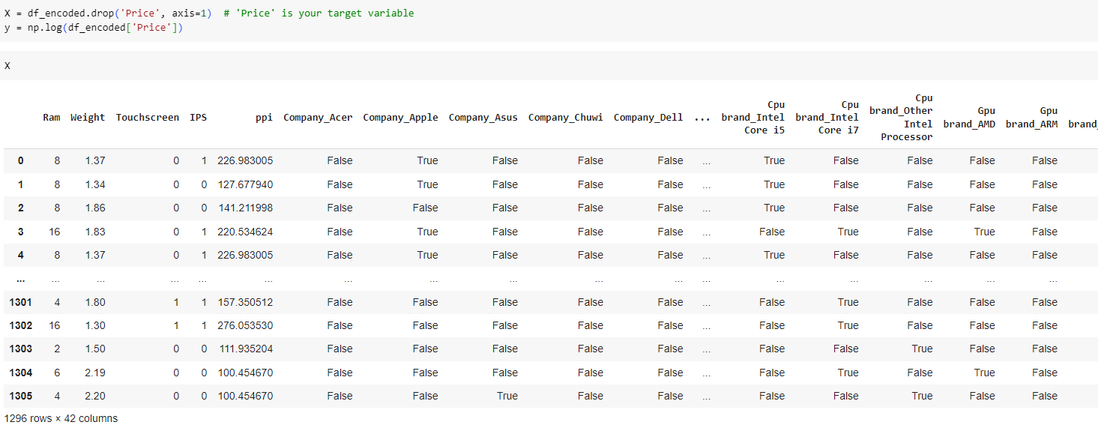
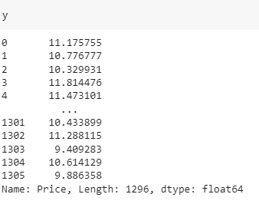
Building The Model
Dividing the df into X and y

Slide 27
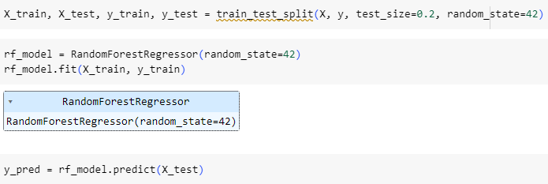
Building The Model
Splitting the data into Test and Train and applying Random Forest regression

Slide 28
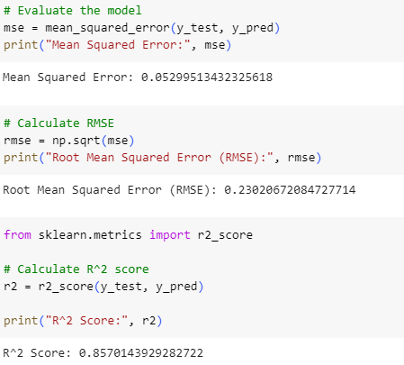
Model Evaluation

Slide 29
Thank You!

